Slide 1
World Food Production
(Group 2) Sargent, Wirsing, Mayo, Wright

Slide 2

The Problem
According to the United Nations Food and Agriculture Organization (FAO), by 2050, our world population is expected to grow from 7.3 billion today to 9.7 billion.
Food production will have to increase by 70% if we are to feed everyone.
This presents an enormous challenge and creates the need to find sustainable ways to grow food to feed this expanding population.

Slide 3
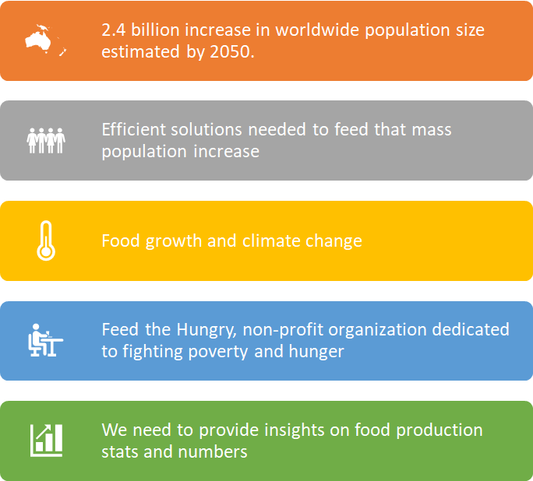
Problem Visual
Just like the challenge is enormous, the solutions and approaches we employ to tackle this challenge and achieve food security must be broad.

Slide 4
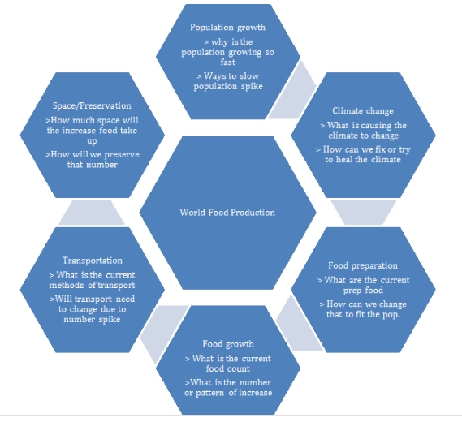
Concept Map

Slide 5
Preliminary Research Questions
Why is there going to be such a population boost in 31 years?
What do the world’s highest producing food countries produce and how?
How much space do we need to farm and distribute the food?
Why is it that some of the largest countries in the world produce very little food?
What kinds of foods are being produced and the easiest to grow?

Slide 6
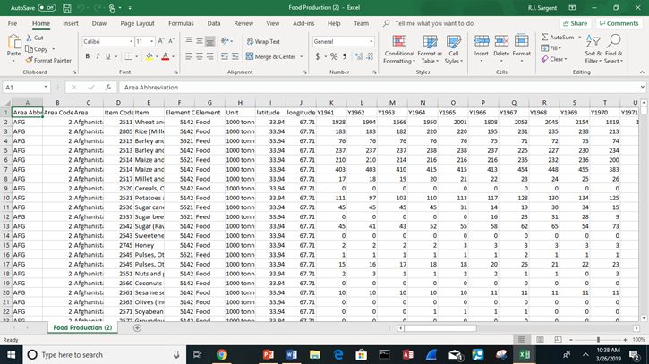
Unwrangled Data Set
Total number of variables is 64
Total number of observations is close 21,478
Purpose, Origin

Slide 7
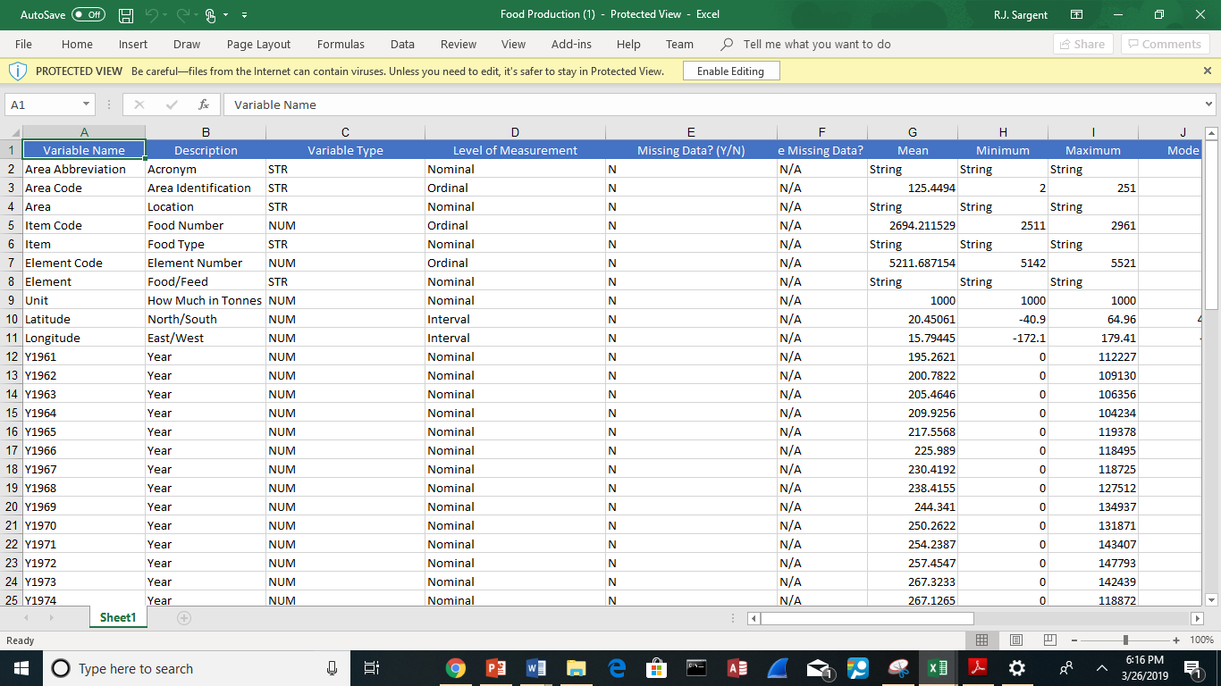
Wrangled Data Set
There are categories for each variable as well as variable types.
We included headers like variable name, level of measurement and others.
Mathematical equations were included like mean, minimum and maximum.

Slide 8
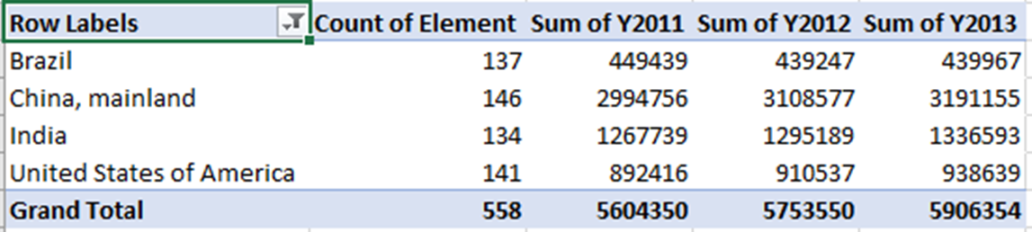
4 top food producers and elements they produce
The 4 top food producing countries are China, United States of America, India, Brazil
China, India and the United States are also the top 3 in the world population
We look at the food being produced and how they are so efficient at producing such volumes, use it as a model.

Slide 9
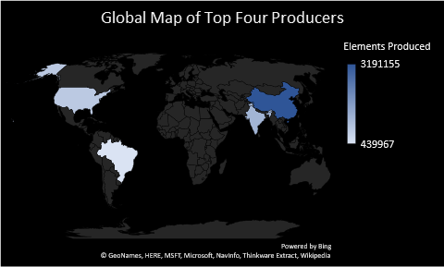
Map of Top Four Producers
US
China
India
Brazil
Top Four Food Producers (China, India, US, Brazil) and Items Made in the year 2013

Slide 10
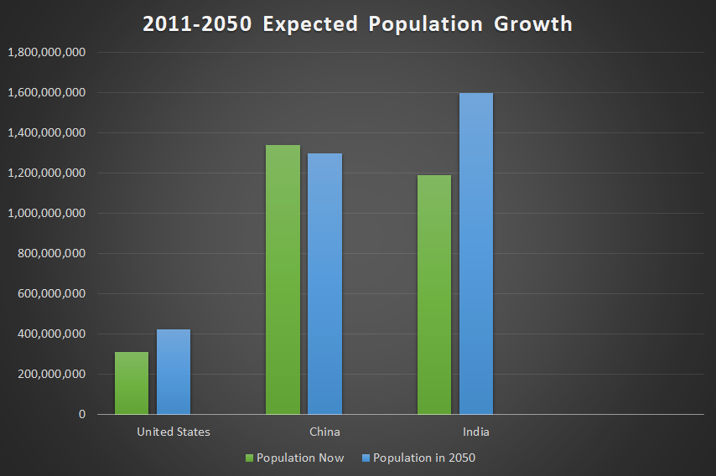
Projected Population Growth
New estimates from the U.S. Census Bureau put China in the lead with 1.34 billion residents, followed by India with 1.19 billion. The United States is a distant third with 311.1 million people.
The bureau envisions India taking the worldwide lead by 2050, when its estimated population will be 1.66 billion. The comparable 2050 projections for China and the United States are 1.30 billion and 422.6 million, respectively.

Slide 11

Answering the Final Research Questions
What did we learn from the data analysis?
We learned that U.S, India and China are growing at rapid rates
We learned also from the data analysis is that as our nation grows the food production will have to grow tremendously as well.
That food production would have to increase at a faster rate than the growth of the nation to keep up.

Slide 12
Final Recommendations
What are the recommendations?
To alleviate this crisis we can begin to grow better crops, simply eat less meat, and target food for direct consumption. (Crops are not always used for food for humans, they are also used for things like oil, clothes,plastic and cosmetics.)
Suggestions for future research
The food and dietary behavior of humans. We believe that a good percentage of humans just eat too much food.
Research if there can be a link between technology and food

Slide 13
Data Science Discussion
What did the data science process teach us?
What we enjoyed
What we did not enjoy

Slide 14
Sources
Gmo, and Gmo. “The Enormous Challenge Of Sustainably Feeding An Expanding Population.” Medium, Medium, 12 June 2017,
medium.com/@gmoanswers/challenge-sustainably-feeding-expanding-population-33bcee94757c.
Thomas,Scott.Bizjournals.com,www.bizjournals.com/bizjournals/on-numbers/scott-thomas/2011/07/china-india-and-us-are-top-3-population.h
Tml.
https://www.treehugger.com/sustainable-agriculture/5-ways-improve-global-food-security.html

